Slide 1

60% Presentation
AI-Assisted Learning Management System
Hanzla Nouman CIIT/FA21-BSE-015/ATD
Laiba Binta Tahir CIIT/FA21-BSE-019/ATD
Arfah Ali CIIT/FA21-BSE-080/ATD
Supervisor
Mr. Mukhtiar Zamin
Department of Computer Science
COMSATS University Islamabad, Abbottabad Campus

Slide 2
Agenda of the Presentation
Brief Introduction
Scope
Functional & Non-Functional Requirements
Use Case Diagram
Class Diagram
ER Diagram
System Block Diagram
Schedule
Conclusion

Slide 3
Brief Introduction
AI-Assisted LMS Overview:
Automates content creation, grading, recommendations, and analytics.
Provides a personalized, adaptive learning experience for students.

Slide 4
Scope
What are we Doing?
Included Features
What are we not Doing?
Content Generation
Content Recommendations
AI-Driven Evaluation
Data Analytics
Excluded Features
Diaries
Real-Time Communication
Parent Engagement
Automated attendance

Slide 5
Functional Requirements
Feature 1: Content Generation
FR-CG-01: Teachers can auto-generate lectures by inputting objectives, topics, and references.
FR-CG-02: Teachers can edit and refine AI-generated content.
FR-CG-03: Flexible options to save lectures as drafts or publish them for student access.
Feature 2: Automated Evaluations
FR-AE-001: Real-time feedback after quiz submissions to highlight improvement areas.
FR-AE-002: AI-powered self-assessment for written and multiple-choice responses.

Slide 6
Functional Requirements
Feature 3: Performance Analytics
FR-PA-001: Analytics Dashboard Visualized trends on student performance, attendance, and engagement.
FR-PA-002: AI predicts future performance using learning patterns and attendance data.
Feature 4: Personalized Learning
FR-PL-001: Tailored learning material based on students' history, preferences, and performance metrics.
FR-PL-002: Teachers can create interactive content (quizzes, assignments) customized to student needs.

Slide 7
Non-Functional Requirements
Performance
Reliability
Usability
Scalability
Maintainability
Security

Slide 8
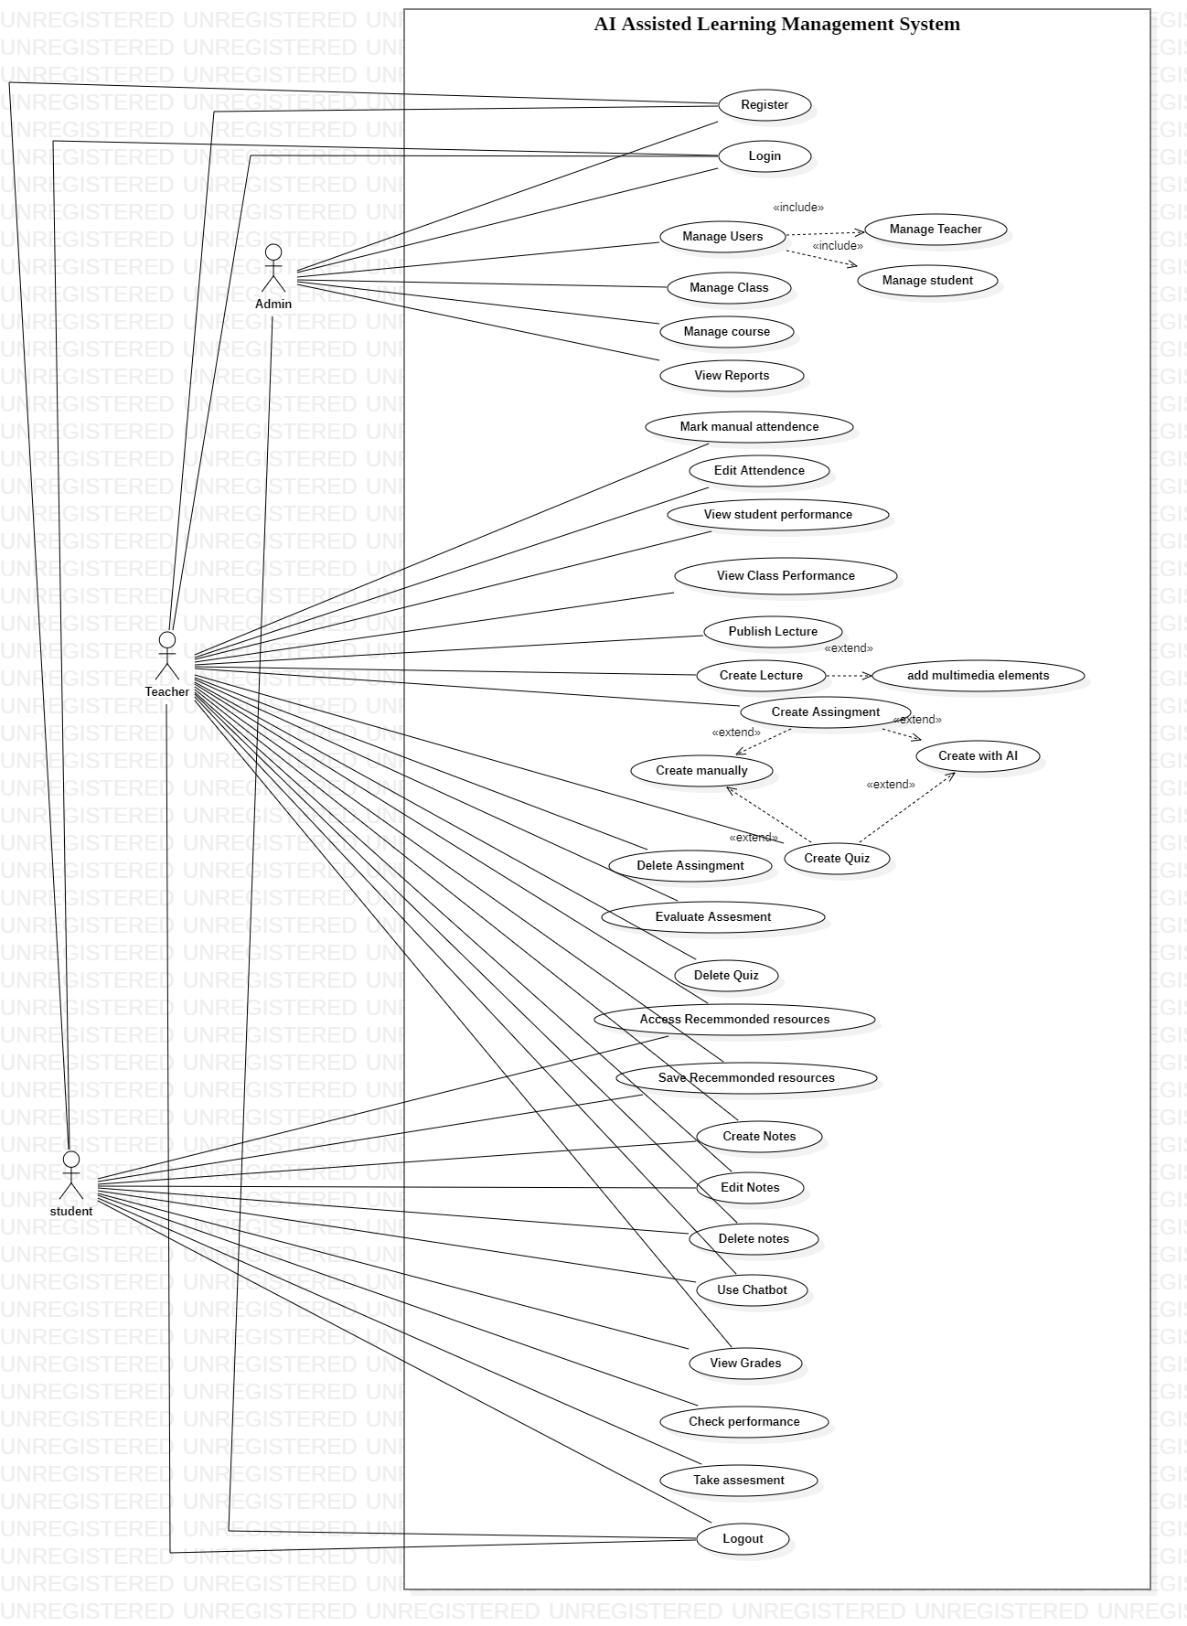
Use Case Diagram
Figure 1.1: Use case Diagram (Tool: StarUML)

Slide 9
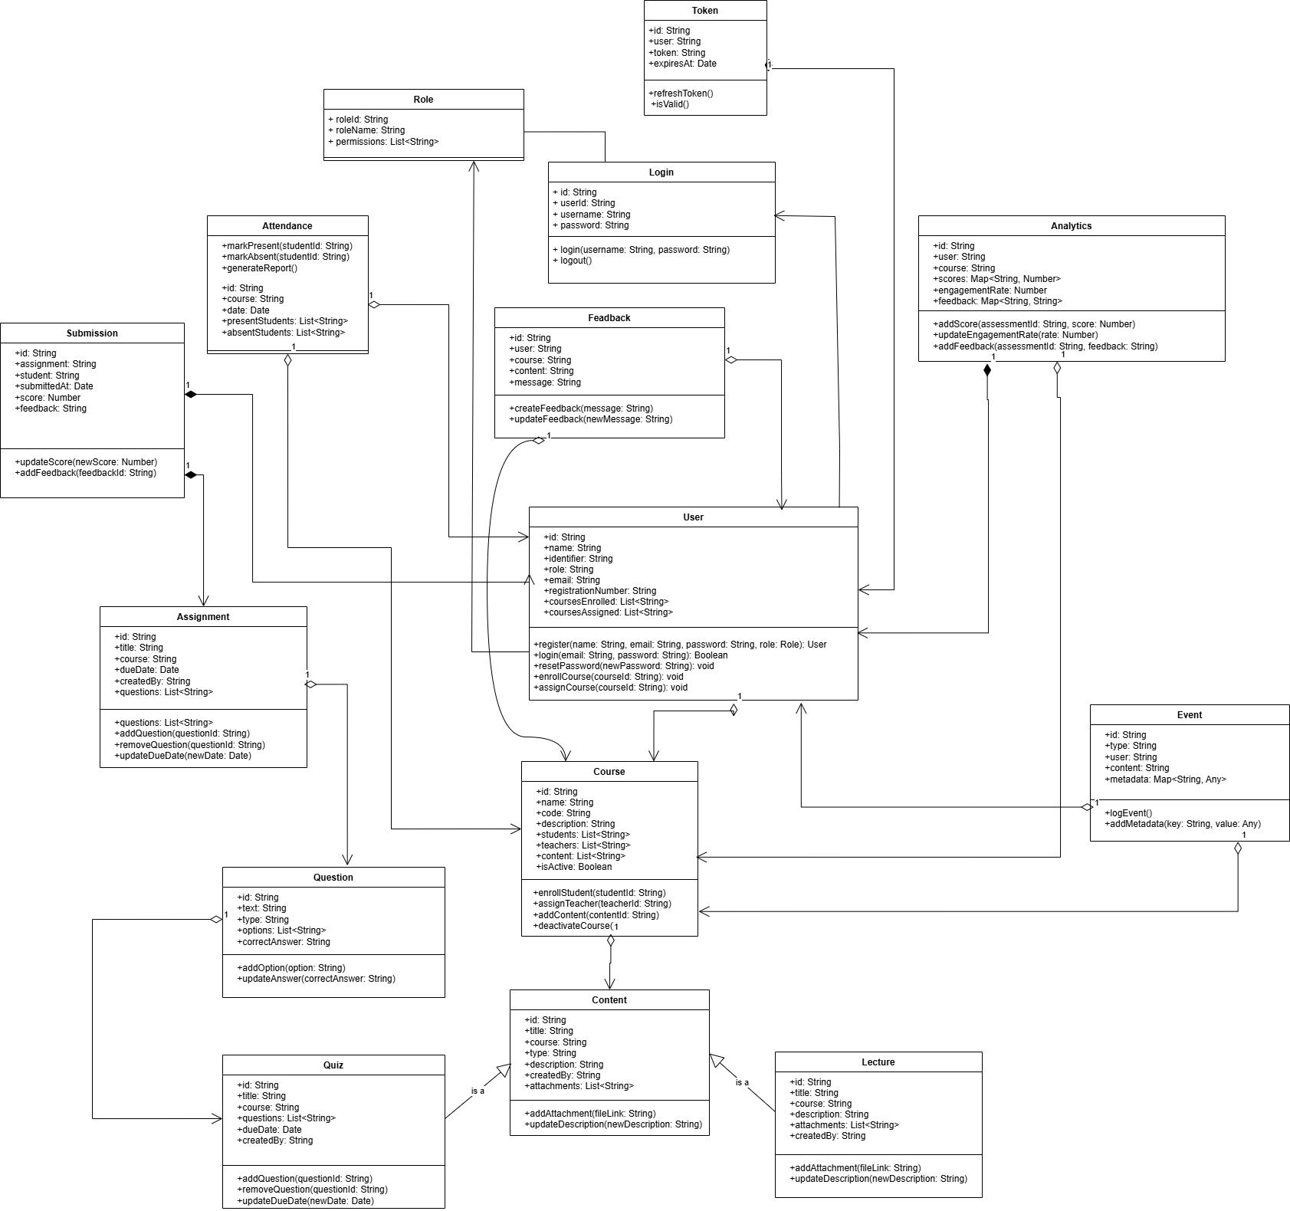
Class Diagram
Figure 1.2: Class Diagram (Tool: Drawio)

Slide 10
E-R Diagram
Figure 1.3: ER Diagram (Tool: Drawio)

Slide 11
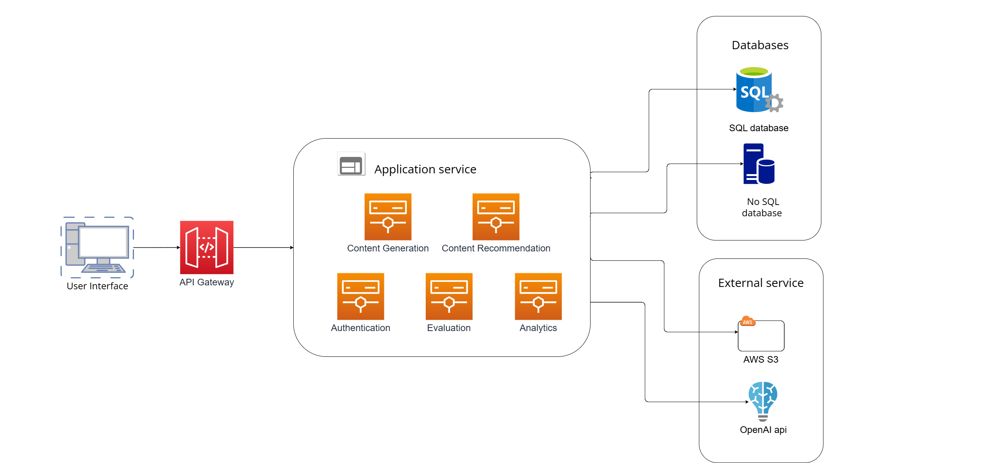
System Block Diagram
Figure 1.4: System Block Diagram (Tool: Visual Paradigm)

Slide 12
Summary of 60% Project Implementation

Slide 13
Details of 1st Iteration (30%)
Software Requirements Specification Document
Software Design Description Document
Basic Content Generation And LMS Activities

Slide 14
Details of 2nd Iteration (60%)
Data Synthesizing for ML Model
Initial Model Training for all Modules
Evaluation and Recommendation Module Functional
Data Pipeline for Continuous Data Stream

Slide 15
Details of 3rd Iteration (100%)

Slide 16
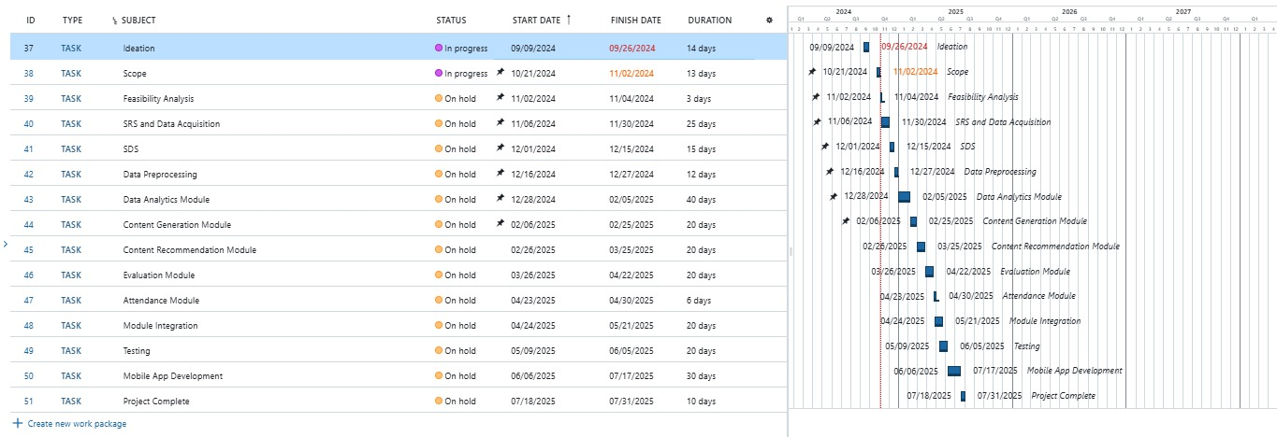
Schedule
Figure 1.5: Gantt chart

Slide 17
Conclusion
AI-Assisted LMS aims to improve educational outcomes by reducing teacher workload, offering personalized learning, and utilizing data-driven insights.

